Slide 1
DSA-3 | PBL REVIEW 3
Automated
Question Bank
Generation System
Q
TEXTQUEST
From educational documents to an organized, searchable and reusable assessment engine.
ADVANCED ALGORITHM QUESTION BANK
SECTION A5
Sai Ganesh Reddy • Jaswanth Reddy
Krishna Biradar • Pradeep

Slide 2
SYSTEM WORKFLOW
A clear path from content to assessment
Each stage transforms raw documents into a usable question bank.
01
02
03
04
OUTPUT LOOP
Educational
Documents
Document
Loading
Text
Processing
Topic & Keyword
Identification
08
Search • Filter •
Question Paper
05
06
07
Question
Generation
Difficulty
Classification
Question
Bank
STRUCTURED
REUSABLE
SEARCHABLE
The result feeds directly into retrieval and automatic paper creation.

Slide 3
REVIEW 2 → REVIEW 3
From proposed concept to working prototype
A measurable shift from planning to implementation.
REVIEW 2 • PROPOSED
REVIEW 3 • IMPLEMENTED
Literature review
Research gaps identified
Automated system proposed
Generation, organization and retrieval defined
Java console prototype
15 documents • 911 words indexed
6 major topics identified
Generation, search, filtering and paper creation
Algorithm Lab implemented
WORKING
PROTOTYPE

Slide 4
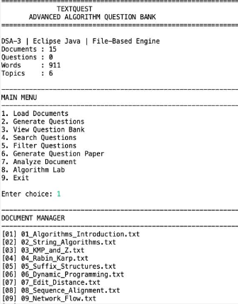
ARCHITECTURE
Eight connected components
A modular design keeps loading, generation, retrieval and analysis distinct.
TEXTQUEST • DOCUMENT MANAGER
01
Document Manager
02
Question Generator
03
Question Bank
04
Search Questions
05
Filter Questions
06
Question Paper
07
Document Analysis
08
Algorithm Lab
15 documents • 911 words • 6 topics

Slide 5
UNDER THE HOOD
DSA algorithms powering the system
Core algorithm modules support search, analysis and experimentation.
STRING / TEXT
DYNAMIC PROGRAMMING
01
KMP
01
Edit Distance
Pattern searching
Similarity & fuzzy matching
02
Z Algorithm
02
Sequence Alignment
Pattern analysis
Structured comparison
03
Rabin–Karp
String matching
04
Suffix Array
Text indexing

Slide 6
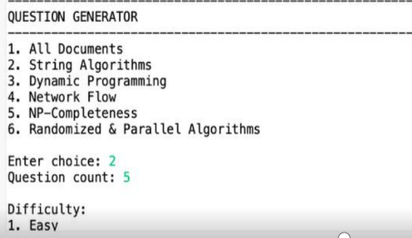
GENERATION ENGINE
Question generation & difficulty classification
A controlled six-step pipeline with duplicate protection.
1
2
3
4
5
6
Select topic
Set count
Choose difficulty
Generate
Reject duplicates
Save to bank
QUESTION GENERATOR • TOPIC + COUNT + DIFFICULTY
DIFFICULTY LEVELS
EASY
MEDIUM
HARD
MIXED

Slide 7
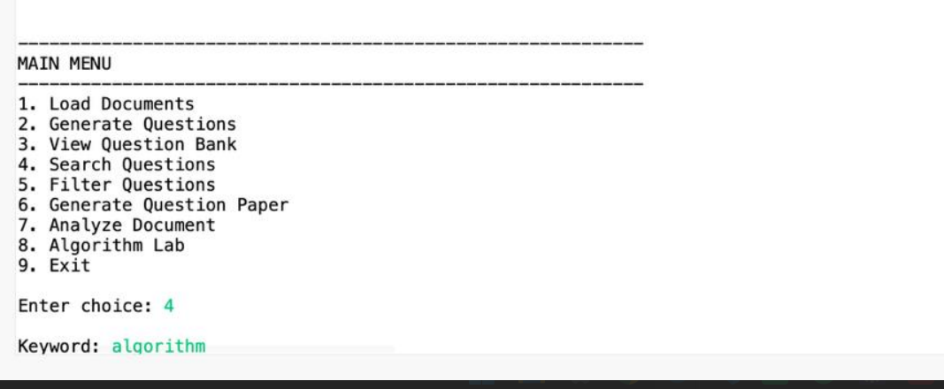
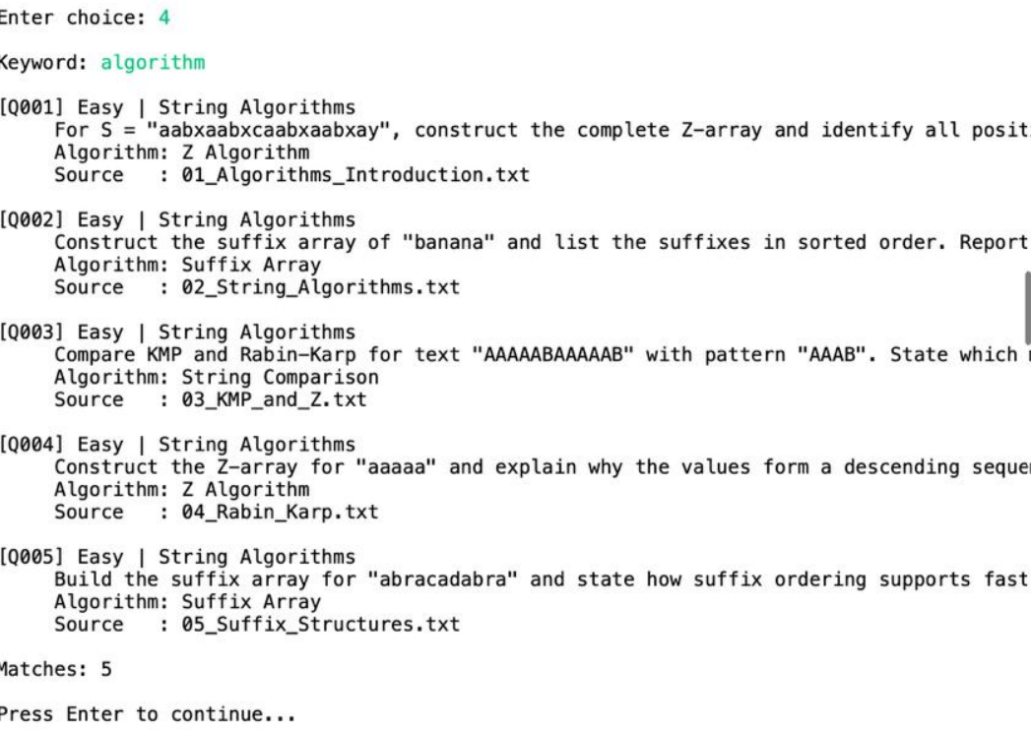
RETRIEVAL
Question bank — search & filtering
Find the right question by keyword, topic, difficulty, algorithm or source.
Q
BANK
⌕
SEARCH
≡
FILTER
Organized repository
Keyword retrieval
Focused results
Topic • Difficulty • Algorithm • Source
Fast matching across generated questions
Refine by topic and difficulty
SEARCH MENU
MATCHING QUESTIONS • KEYWORD: ALGORITHM

Slide 8
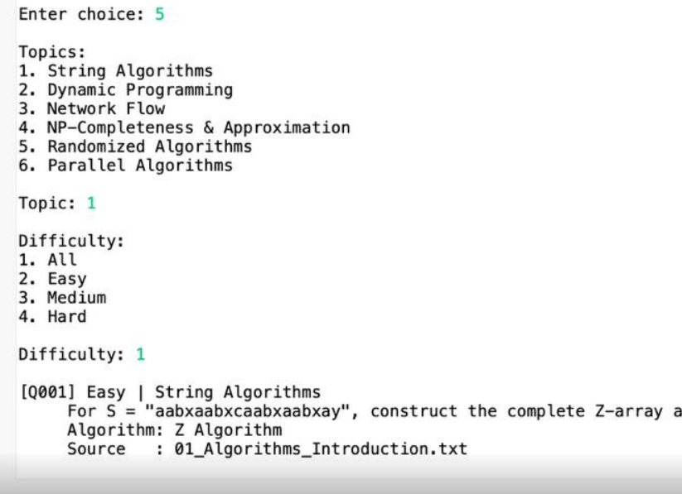
ASSESSMENT OUTPUT
Automatic question paper generation
A simple selection flow converts the question bank into an assessment-ready paper.
1
Choose topic
2
Choose difficulty
3
Set question count
4
Generate paper
FILTERED QUESTION SELECTION
QUESTION SELECTION
Specify the required number
Select topic and difficulty
Draw from the saved question bank
Produce a ready-to-use paper

Slide 9
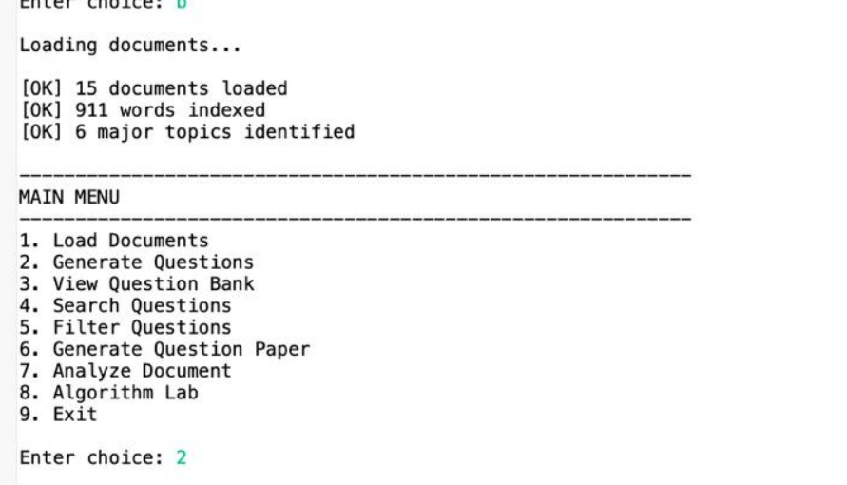
VALIDATION
Implementation evidence
Prototype results demonstrate end-to-end execution.
15
911
6
5
Documents
Words indexed
Major topics
Demo questions
SUCCESSFUL DOCUMENT LOADING
GENERATED QUESTION OUTPUT
WORKING PROTOTYPE

Slide 10
NEXT
CHAPTER
LIMITATIONS, FUTURE SCOPE & CONCLUSION
CURRENT LIMITATIONS
Console-based interface
Depends on supplied corpus
Question quality can improve
Difficulty estimation can improve
From a console prototype to an intelligent assessment platform.
FUTURE SCOPE
Web-based interface
Larger, diverse datasets
Stronger NLP generation and classification
Multi-format question paper export
TEXTQUEST
“From educational content to a structured, searchable question bank.”

